Slide 1
Hybrid Cryptography: Combining Symmetric and Asymmetric Encryption
Done By
Abhidhya Sri Mailsamy Sumitha
192520051

Slide 2
INTRODUCTION
Hybrid cryptography combines symmetric and asymmetric encryption techniques.
It uses the speed of symmetric encryption for data encryption.
It uses the security of asymmetric encryption for secure key exchange.
This approach provides fast, secure, and efficient communication.
Widely used in HTTPS, SSL/TLS, VPNs, email encryption, and online banking.

Slide 3
What is Hybrid Cryptography?
Hybrid cryptography is a method that combines symmetric encryption and asymmetric encryption.
Symmetric encryption encrypts data quickly using a single shared key.
Asymmetric encryption securely exchanges the encryption key using a public and private key pair.
By combining both, hybrid cryptography provides high speed, strong security, and efficient communication.
It is commonly used in HTTPS, SSL/TLS, VPNs, secure email, and online banking.

Slide 4
Need for Hybrid Cryptography
Combines the speed of symmetric encryption with the security of asymmetric encryption.
Enables secure key exchange without sharing secret keys directly.
Provides fast encryption for large amounts of data.
Reduces the computational cost compared to using only asymmetric encryption.
Ensures confidentiality, integrity, and authentication of data.
Protects sensitive information during online communication.
Widely used for secure internet services such as HTTPS, SSL/TLS, VPNs, and secure email.

Slide 5
Components of Hybrid Cryptography
Symmetric Encryption – Encrypts data quickly using a shared secret key.
Asymmetric Encryption – Securely exchanges the secret key using public and private keys.
Session Key – A temporary key used to encrypt data during a session.
Key Exchange – Safely transfers the session key between users.
Hash Function – Verifies data integrity and detects tampering.

Slide 6
Working Principle of Hybrid Cryptography
A session key is generated.
The data is encrypted using symmetric encryption and the session key.
The session key is encrypted using the receiver's public key (asymmetric encryption).
Both the encrypted data and encrypted session key are sent to the receiver.
The receiver uses their private key to decrypt the session key.
The session key is then used to decrypt the original data.
Summary: Hybrid cryptography uses asymmetric encryption for secure key exchange and symmetric encryption for fast data encryption.

Slide 7
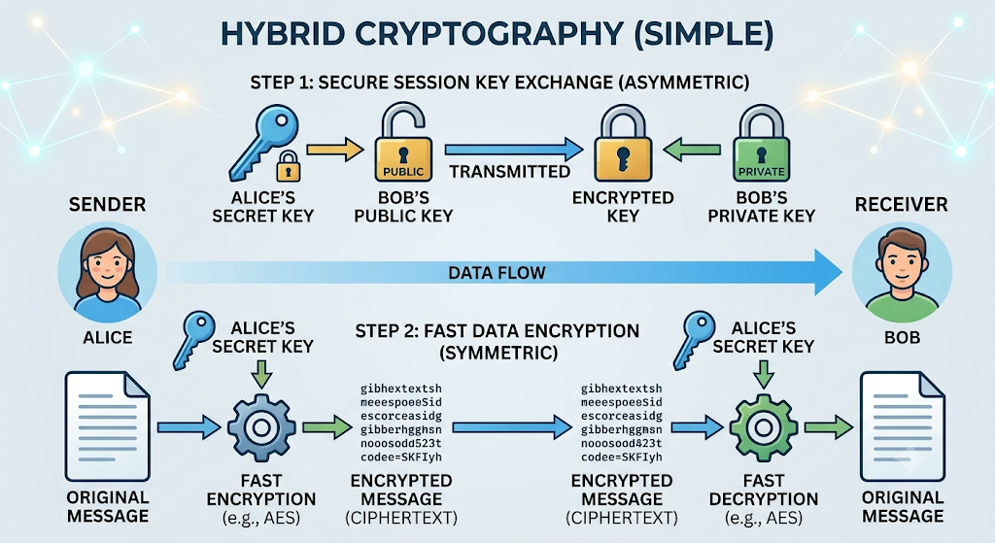
Hybrid Cryptography - Workflow

Slide 8
ADVANTAGES AND LIMITATIONS
Advantages
limitations
Fast encryption and decryption.
Secure key exchange using public-key encryption.
Combines the speed of symmetric and security of asymmetric encryption.
Suitable for large data transmission. Widely used in secure communication protocols.
More complex to implement than a single encryption method.
Requires proper key management.
Asymmetric encryption adds computational overhead during key exchange.
Security depends on the strength of both encryption algorithms.
Vulnerable if private keys are compromised.

Slide 9
Conclusion
Hybrid cryptography combines the speed of symmetric encryption with the security of asymmetric encryption.
It provides fast, secure, and efficient data protection.
It enables secure key exchange and protects sensitive information.
Widely used in HTTPS, SSL/TLS, VPNs, secure email, and online banking.
It is one of the most effective encryption methods for modern digital communication.

